Slide 1
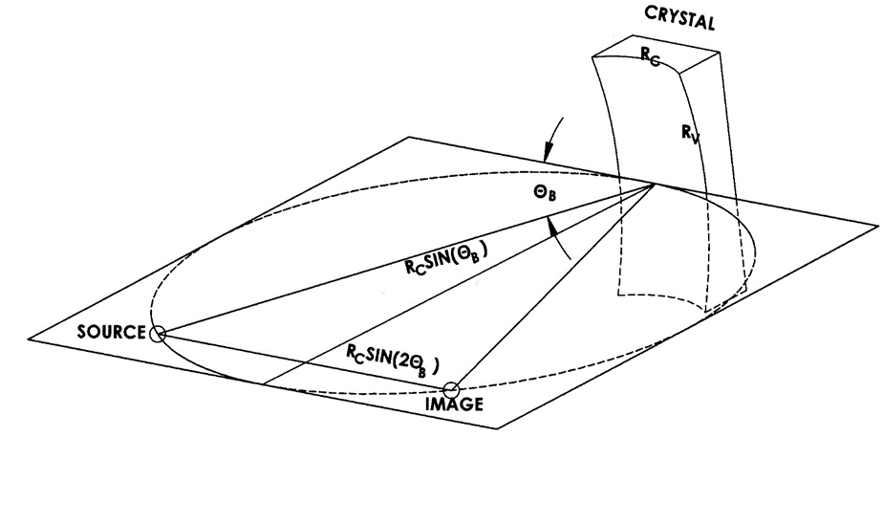
Annual Meeting of Shareholders
We improve the world’s safety, security and scientific understanding
by transforming challenging requirements into optical realities.
June 8, 2021

Slide 2
Who We Are:
Vertically integrated with extensive optical fabrication capabilities, Inrad Optics manufactures high-precision optical components from glass, crystal and metal. Expertise includes proprietary crystal assemblies for nanoscale surface analysis, production of extreme precision optical surfaces and large form factor optics. R & D, engineering and manufacturing operations are conducted in New Jersey by a talented, committed and diverse workforce.

Slide 3
Our Value Proposition in a Fierce and Fragmented Marketplace:
We addresses an unmet need in the custom optical components and sub-systems marketplace.
We focus on high barrier to entry and niche optical technologies
We take on engineering intensive build-to-print OEM projects
We offer concurrent engineering services to shrink development cycle time and optimize designs for manufacturability
We offer best in class optical materials expertise

Slide 4
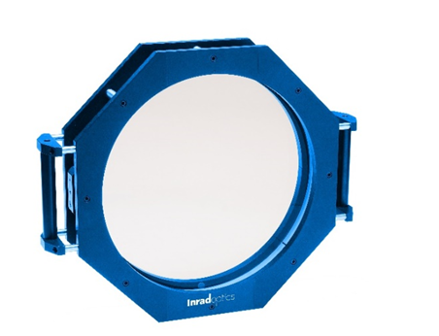
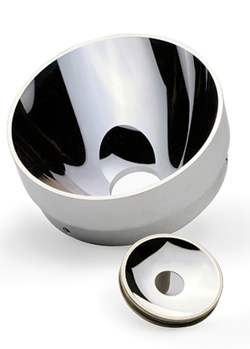
Crystals to Coatings
Crystalline Materials & Devices
Glass & Glass-like Optics & Assemblies
Metal Substrate Optics & Assemblies

Slide 5
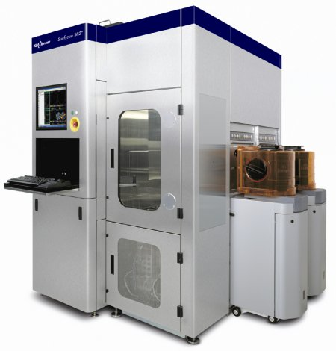
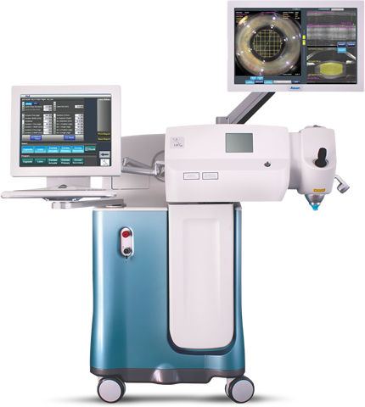
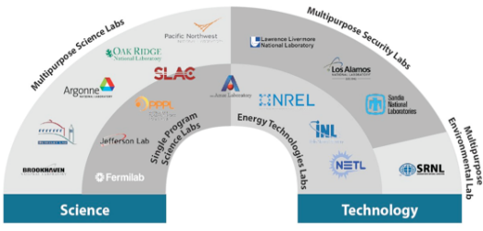
Markets & Applications
Process Control and Metrology
Aerospace & Defense
Large, extreme precision optics
for semiconductor
wafer inspection
Mirrors, lenses,
filters for
targeting
& night vision
Laser Systems
Universities & National Labs
Crystal device used in laser cataract surgery
Stilbene crystal for nuclear materials detection

Slide 6
Our goal: Continue to grow defense, space & x-ray optics to mitigate revenue gaps from cyclic semiconductor equipment segment(PC&M), rationalize product offerings, and leverage unique expertise to provide growth and return shareholder value

