Slide 1
Annual Meeting of Shareholders
June 27, 2018

Slide 2
What We Do:
We are a manufacturer of exceptional quality crystalline materials, fabricated high precision glass and metal optical components and devices used in lasers and other light based systems.

Slide 3
Why We Do It:
We improve the world’s safety, security
and scientific understanding
by transforming challenging requirements
into optical realities.

Slide 4
Fast Facts:
Established 1973
Publicly Traded
42,000 sq. ft. facility
Vertically Integrated
US State Dept. ITAR Registered
ISO – 9001 Certified

Slide 5
Our Value Proposition in a Fierce and Fragmented Marketplace
We addresses an unmet need in the custom optical components and sub-systems marketplace.
We focus on high barrier to entry and niche optical technologies
We take on science & engineering intensive multi-dimensional optical projects
We offer concurrent engineering to shrink development cycle time and optimize customer’s design for manufacturability
We offer best class optical materials expertise

Slide 6
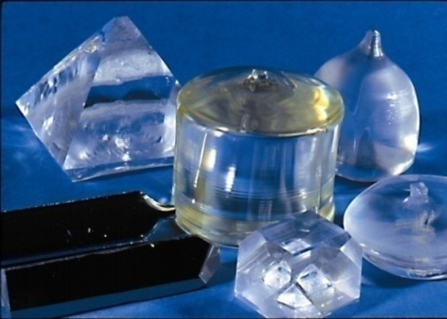
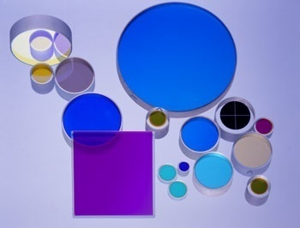
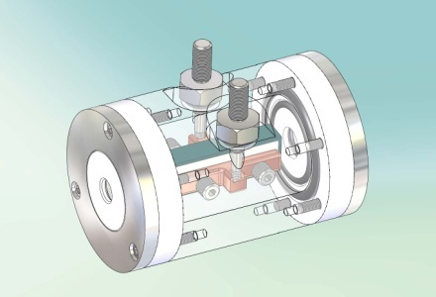
Vertical Manufacturing:
Grow Crystals
Cut & Polish Optics
Design and Assemble
Electro-optical Devices

Slide 7
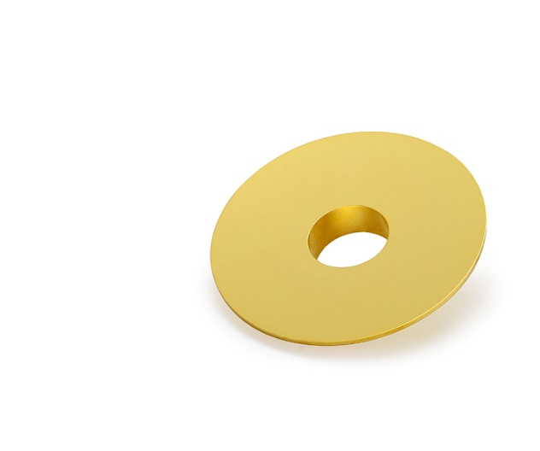
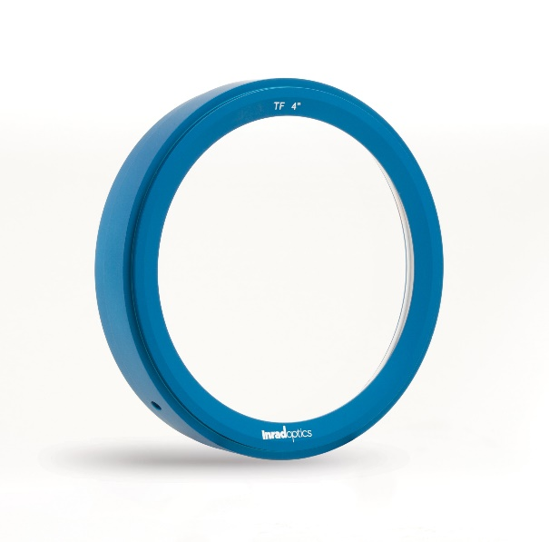
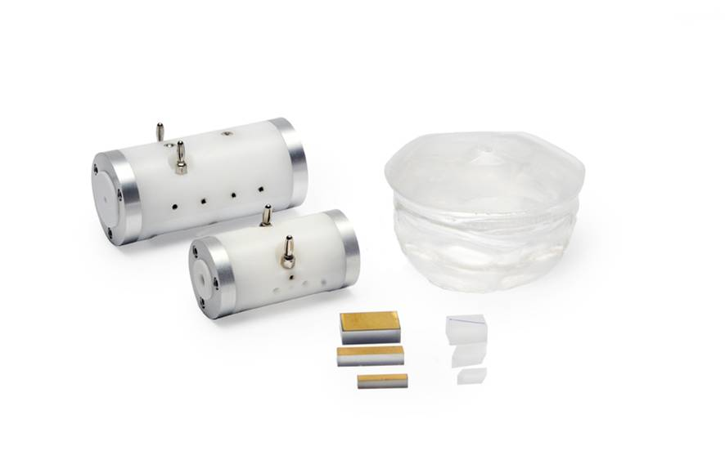
Crystals to Coatings
Three Product Segments:
Crystalline Materials & Devices
Glass & Glass-like Optics & Assemblies
Metal Substrate Optics & Assemblies

Slide 8
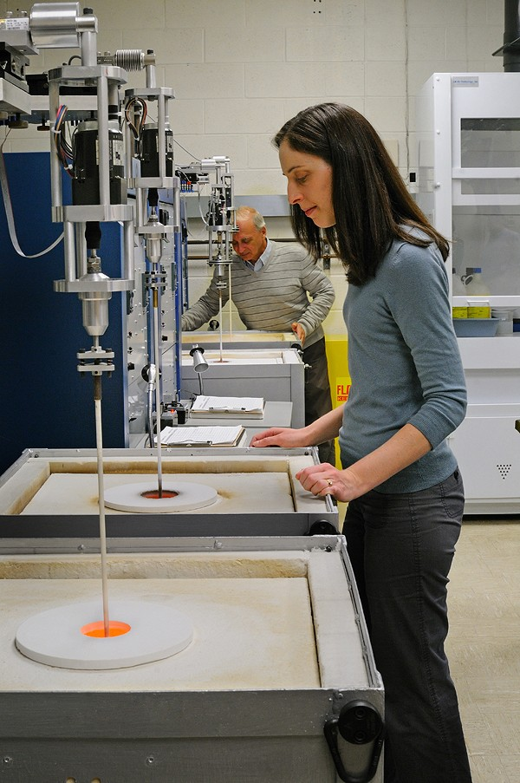
Crystalline Materials & Devices
High Temperature Furnace Growth Crystals
Lithium Niobate – EO modulator for laser
communications and other devices
BBO – Light conversion crystal used in
Alcon laser cataract removal system
Solution Growth Crystals
UV Filter Crystals – installed in system on
Combat aircraft & Air Force 1.
KD*P – R &D High Power Lasers,
Fusion Energy studies
ScintinelTM Stilbene – Nuclear detection

Slide 9
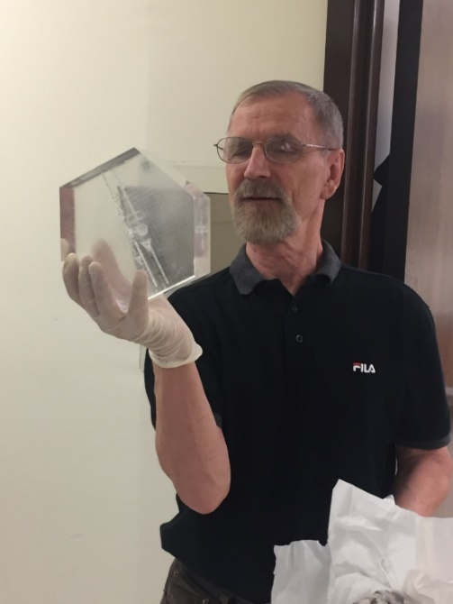
Scintinel™ Stilbene
Emits light in the presence of nuclear radiation.
Breakthrough in nuclear radiation detection associated with border security and terroristic threat reduction.
6 science and technology awards –
DHS to Popular Science’s Best of What’s New 2015.

Slide 10
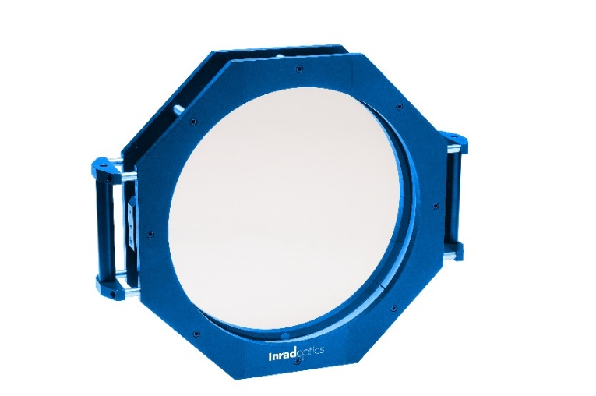
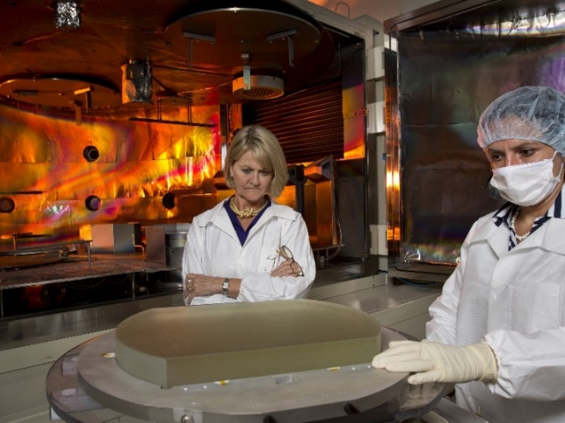
Glass & Single Crystal
Unique High Precision Optical Components
Large & Complex Optomechanical Assemblies
Optomechatronic Sub-Systems

Slide 11
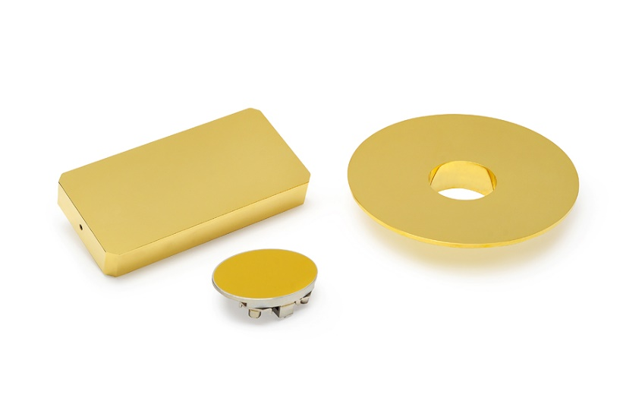
Metal Optics
Unique High Precision Optical Components
Complex Optomechanical Assemblies
Optomechatronic Sub-Systems

Slide 12
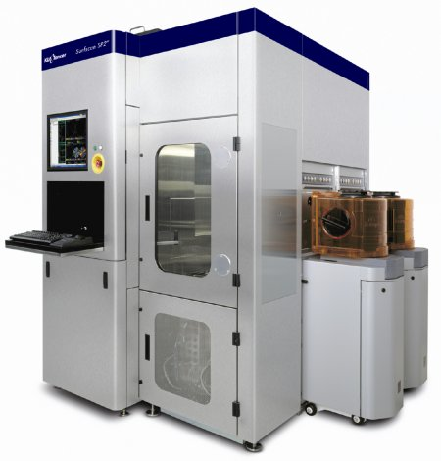
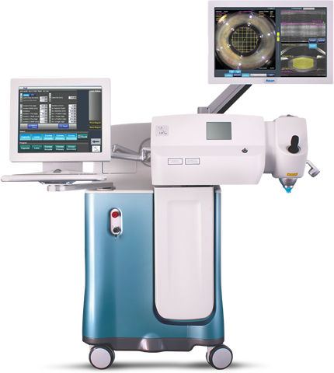
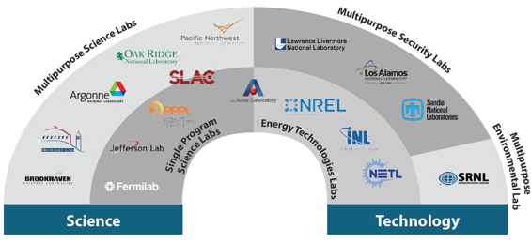
Markets We Serve
Process Control and Metrology
Aerospace & Defense
Laser Systems
Universities & National Labs
Notes:
Inrad Optics markets to key industries such as aerospace & defense, national labs, university research centers, laser OEMs, semiconductor equipment manufacturers, and process control system integrators.

